Slide 2
Contents page
Introduction
Welcome video
The National Discussion's Questions
Task Menu
  Task 1: Draw the perfect place for learning in the future
  This option has learner to draw their ideal place of learning. Followed by a facilitated discussion.
  Task 2: Imagine if…
  This option sees learners critique scenarios for future learning.
  Task 3: UNCRC for me?
  This option sees learners reflect on their right to an education that develops their personality, talents, mental & physical abilities to their fullest potential.
  Task 4: Open-ended, creative response
  This option sees groups of learners respond directly to the National Discussion's consultation questions
Creative feedback suggestions
What happens next?

Slide 3
Introduction
This adaptable discussion guide was developed to help teachers, parents / carers, peers, youth workers, and others help groups of young adults take part in the National Discussion on Scottish Education.
This resource should help you to create spaces where learners can consider, discuss and reflect on what they expect from education.
Feedback from testing this guide led us to provide menu of activities for you to choose from.
Please look at the options and decide how you might use (or adapt) them to meet the needs and interests of your group.
This guide has been designed with learners over 15 years old in mind but it can also be used with children and young people of all ages who may respond best to this approach.

Slide 4

Welcome
Professor Carol Campbell and Professor Alma Harris are helping to co-facilitate the National Discussion on Scottish Education. One of their jobs is to help make sure that anyone who wants to can take part. Click here to watch a video of how they plan to engage everyone and particularly those we don’t normally hear from in the national discussion.
Video: Meet the National Discussion’s independent facilitators Prof Carol Campbell and Prof Alma Harris
https://www.youtube.com/watch?v=U0BaSciflZQ

Slide 5
The National Discussion's Questions
The activities in this guide prepare learners to answer the national discussion's key questions.
Key Questions
What kind of education will be needed by children and young people in Scotland in the future and how do we make that a reality?
How do we ensure that children and young people in Scotland feel supported in their learning in the future?
What is one thing that needs to stay and why ?
What are the most important priorities for a future Scottish education system?
How can we make that future vision for education a reality in Scotland?
How can we ensure that everyone involved in education in Scotland has a say in future decisions and actions?

Slide 6
The National Discussion's Questions
The guide will also help learners take an in-depth look at topics of interest to them. For example:
Our Future Learning: How can high quality educational experiences, teaching, and learning be best supported for children and young people in Scotland?
Our Future Equity: How can every child and young person’s individual needs be supported and addressed in
the future?
Our Future Well-Being: How can children and young people’s mental, emotional, social, and physical wellbeing and safety be cared for and supported in the future?
Our Future Rights: How can the right of every child and young person to have opportunities to develop their full potential be achieved in future?
Our Future World: How can children and young people be helped to learn about our changing world, so they feel able to positively contribute?
Opportunity for Additional Comments Do you have any other comments that you would like to provide about a vision for the future of Scottish Education?

Slide 7
Task 1: Draw the perfect place for learning in the future (50 mins)
Outline
Facilitator-led context setting: learning & the future (5 mins)
Individual drawing task (5 mins)
Pair & Share drawings (5 mins)
Facilitated discussion (10 mins)
Writing vision statements (10 mins)
Time to respond to survey questions (15 mins)
Anticipated outputs
Individual drawings
Vision statements
Readiness to answer the national discussion's consultation questions

Slide 8

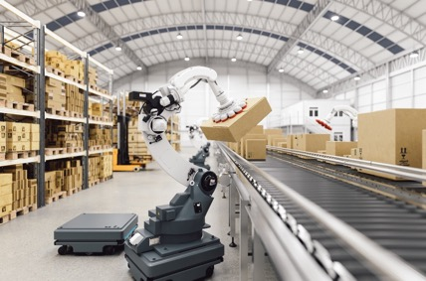
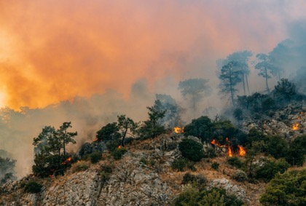


The future?
#TalkScottishEducation
Notes:
Based on www.w2050.org megatrends
EXPONENTIAL TECHNOLOGIES RADICALLY RESHAPING THE WORLD.
DISRUPTION FROM CLIMATE CHANGE, ENERGY TRANSITION IS ONLY THE BEGINNING.
THE WORKPLACE CARES LESS ABOUT EDUCATION, MORE ABOUT SKILLS.
SOCIETAL DISTRUST, FRAGMENTATION ARE SURGING.
DEMOCRATIC GOVERNANCE INSTITUTIONS UNDER PRESSURE.

Slide 9
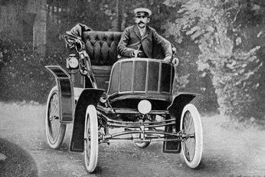
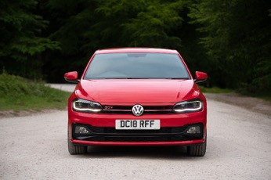
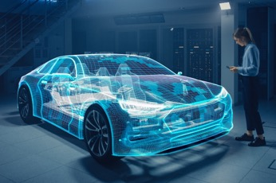
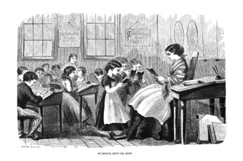


Prompts – Thinking about the future
#TalkScottishEducation
Notes:
With cars, we can guess what is coming next. With education, you have the opportunity to shape what is coming next.
Emphasising that YOU have the opportunity to shape what Scottish education looks like.
YOUR voice is really important

Slide 10


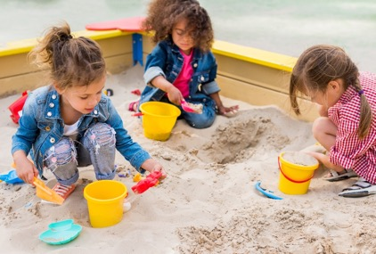


Think about all of your education so far…
… and think about that future
#TalkScottishEducation
Notes:
Questions for provocation / discussion:
Where do you learn?
Learning outside of school? With family, youth groups, sports teams… just by being a brother, sister, uncle, granddaughter…
What do remember most about your time at nursery / primary / early secondary school? Trips, visits, experiences…
What has been really strong? What learning have you valued most?
What kind of learning really gets you fired up & curious? Excites you?
What bores you? What’s been a waste of time?
What learning is important in this community? ( settings could add own photos / context, if desired)

Slide 11

Individual task
Think about learning in the future…
Draw the perfect place to learn.
(imagine it’s the year 2042)
No text or words allowed!
4 minutes

Slide 12

Pair task
Think about the places we will learn
in the future…
Explain your drawing to your partner.
Listen really carefully to your partner’s explanation
(you will need to explain their drawing soon!)
2 minutes each to talk

Slide 13

Group task
Think about the places we will learn in the future…
Join with another pair.
Explain your partner’s drawing to the whole team.
Then
As a team, write down some words that describe the things you have been talking about.
Don’t worry about sentences – just words for now

Slide 14
Whole group discussion
Think about the places we will learn
in the future…
Facilitator / teacher leads whole group / whole-class discussion
Take points from each group
Use prompt sheet (prompt questions) to explore issues in more detail and / or to reach areas not yet surfaced
nounproject.com
Notes:
Facilitator uses prompts from key and optional questions to explore particular areas in further depth and / or surface themes which have not come up.
Our Future Learning: How can high quality educational experiences, teaching, and learning be best supported for children and young people in Scotland?
Our Future Equity: How can every child and young person’s individual needs be supported and addressed in
the future?
Our Future Well-Being: How can children and young people’s mental, emotional, social, and physical wellbeing and safety be cared for and supported in the future?
Our Future Rights: How can the right of every child and young person to have opportunities to develop their full potential be achieved in future?
Our Future World: How can children and young people be helped to learn about our changing world, so they feel able to positively contribute?
Opportunity for Additional Comments Do you have any other comments that you would like to provide about a vision for the future of Scottish Education?

Slide 15
Can you think of any?
Some organisations have straplines
But others have a VISION​
Can you think of any?

Slide 16
We really want to know your VISION…
… for Scottish education.
Think about your individual drawings and your team words.
Write a team statement that describes your vision for Scottish education.

Slide 17
Responses
Thank you for taking part in the National Discussion.
These tasks will have helped us all think about some of the National Discussion questions.
Learners should now either work in groups – or with the facilitator - to complete their group's response
via the following link: https://consult.gov.scot/learning-directorate/national-discussion-feedback
Or, complete their own personal response via the following link:
https://consult.gov.scot/learning-directorate/national-discussion-on-education
If neither of these options fit your group's needs, you can instead choose to email a summary to: nationaldiscussiononeducation@gov.scot, or post on social media #TalkScottishEducation
(via Instagram or Twitter). Please remember to include a rough description of who was in your group and how many people took part.

Slide 18
Task 2: Imagine if…
Outline
Facilitator-led context setting: what it means to be successful and ICEA report (10 mins)
Individual, pair or group idea generation options (15 mins):
Mind-map
ABC Avalanche
Tomorrow's News
Facilitated discussion (10 mins)
Time to respond to survey questions and summarise responses (15 mins)
Anticipated outputs
Ideas list from class or groups – our top ideas
Summarised ideas
Photos or scans of mind-maps, ABC grids or Newspaper covers
Readiness to complete survey questions

Slide 19
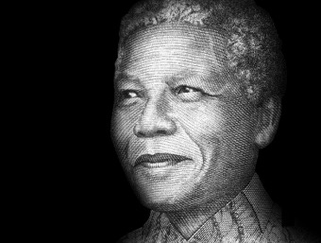
What does it mean to be successful?
“In judging out progress as individuals we tend to concentrate on external factors such as one’s social position, influence and popularity, wealth and standard of education. These are, of course, important in measuring one’s success in material matters and it is perfectly understandable if many people exert themselves mainly to achieve all these.
But internal factors may be even more crucial in assessing one’s development as a human being. Honesty, sincerity, simplicity, humility, pure generosity, absence of vanity, readiness to serve others – qualities which are within the reach of every soul – are the foundation of one’s life.”
Nelson Mandela
National Discussion on Scottish Education
Notes:
What do young people consider it means to be successful?
How can education help you be successful in all aspects of your life, learning and work?

Slide 20
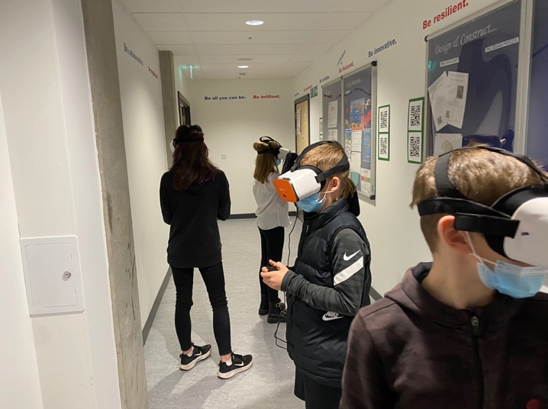
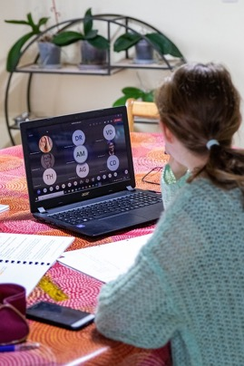
We’ve seen that learning can change..
#TalkScottishEducation

Slide 21
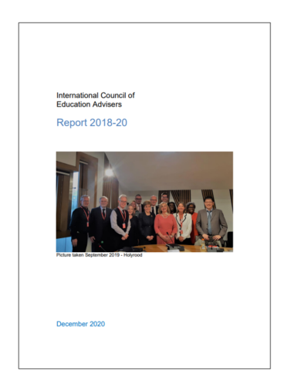
Think about this quotation…
The future Scottish educational
system ''will be both more digital
and more natural.
It will also be a more sustainable
education system."
(ICEA, 2021)

Slide 22
Think broadly about the future…
“If I asked people what they wanted, they would have said ‘faster horses’.”
Henry Ford
“The horse is here to stay but the automobile is only
a novelty – a fad.”
President of Michigan Savings Bank
National Discussion on Scottish Education
National Discussion on Scottish Education

Slide 23
Imagine if…
… all schools were connected internationally…
… you could select learning from a menu like Netflix…
… Artificial Intelligence meant you take assessments when you felt ready…
… learning was anytime anywhere…

Slide 24
What do you think this could mean for the future of Scottish education?
More digital
More natural
Education
in the year 2042
More...???
Notes:
Option 1 – Learners could mindmap ideas and suggestions for what more digital and more natural could mean.
Ask learners to consider the "More digital" and "More natural" statements along with "more..." anything else they feel education should be.
Encourage learners to think about all the possible ways learning could change between now and 2042.
Prompts could include:
Remote learning
Artificial intelligence
Global connections
Places where we learn
Green technology / economy
Energy
Climate change
Learning for Sustainability...

Slide 25
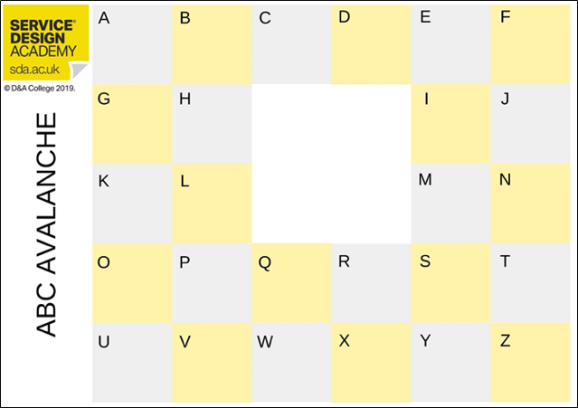
What do you think this could mean for the future of Scottish education?
What does "more digital and more natural" mean to you?
Come up with at least one idea, starting with each letter of the alphabet for a "more digital and more natural" learning experience.
Notes:
Option 2 – Learners could use this ideation (idea generation) tool to come up with one idea, starting with each letter of the alphabet, for a future education which is more digital and more natural.
Ask learners to consider the "More digital" and "More natural" statements along with "more..." anything else they feel education should be.
Encourage learners to think about all the possible ways learning could change between now and 2042.
Prompts could include:
Remote learning
Artificial intelligence
Global connections
Places where we learn
Green technology / economy
Energy
Climate change
Learning for Sustainability...

Slide 26
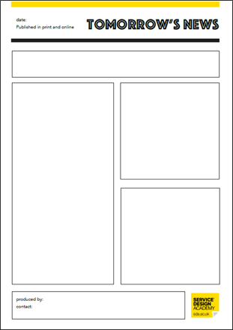
What do you think this could mean for the future of Scottish education?
What does "more digital and more natural" mean to you?
Come up with at least one idea, starting with each letter of the alphabet for a "more digital and more natural" learning experience.
Notes:
Option 3 – Learners could create a future newspaper front cover from the year 2042, describing what "more digital and more natural" learning looks like.
Ask learners to consider the "More digital" and "More natural" statements along with "more..." anything else they feel education should be.
Encourage learners to think about all the possible ways learning could change between now and 2042.
Prompts could include:
Remote learning
Artificial intelligence
Global connections
Places where we learn
Green technology / economy
Energy
Climate change
Learning for Sustainability...

Slide 27
Group discussion
Think about the ideas each group has generated either through the mind-map, ABC Avalanche or Tomorrow's News.
Which bits would you like / dislike?
What’s most important to you?
What will most help future children and young people to be successful?
Can we compile a list of the top or agreed ideas as a class?

Slide 28
Responses
This task will have helped us all think about some of the National Discussion questions.
Learners should now either work in groups – or with the facilitator - to complete their group's response
via the following link: https://consult.gov.scot/learning-directorate/national-discussion-feedback
Or, complete their own personal response via the following link:
https://consult.gov.scot/learning-directorate/national-discussion-on-education
If neither of these options fit your group's needs, you can instead choose to email a summary to: nationaldiscussiononeducation@gov.scot, or post on social media #TalkScottishEducation (via Instagram or Twitter). Please remember to include a rough description of who was in your group and how many people took part.
Notes:
From OECD (2020, p54)

Slide 29
Task 3: UNCRC for me? (50 mins)
Outline
Facilitator-led context setting: the UNCRC (10 mins)
Group knowledge capture task (15 mins)
Facilitated discussion (10 mins)
Time to respond to survey questions and summarise responses (15 mins)
Anticipated outputs
Knowledge capture grids
Summary statements or bullet points
Readiness to answer the national discussion's consultation questions

Slide 30
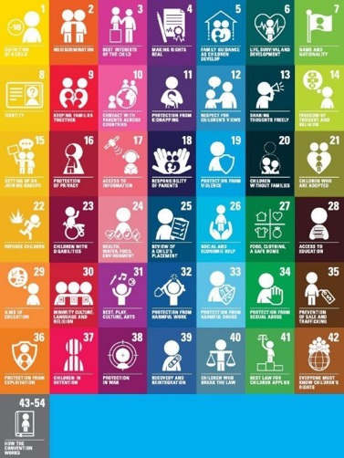
What is the UNCRC?
The United Nations Convention on the Rights of the Child is the most complete statement of children’s rights ever produced and is the most widely-ratified international human rights treaty in history.
The Convention has 54 articles that cover all aspects of a child’s life and set out the civil, political, economic, social and cultural rights that all children everywhere are entitled to. It also explains how adults and governments must work together to make sure all children can enjoy all their rights.
Notes:
Read the full Convention (pdf)
Read a summary of the UN Convention (pdf)
Read a summary of the UN Convention
DOWNLOAD
Read the full UN Convention
DOWNLOAD

Slide 31
Article 29: Aims of Education
Article 29 of the convention describes the aims of education as:
The development of the child’s personality, talents and mental and physical abilities to their fullest potential
The development of respect for human rights and fundamental freedoms, and for the principles enshrined in the Charter of the United Nations
The development of respect for the child’s parents, his or her own cultural identity, language and values, for the national values of the country in which the child is living, the country from which he or she may originate, and for civilizations different from his or her own
The preparation of the child for responsible life in a free society, in the spirit of understanding, peace, tolerance, equality of sexes, and friendship among all peoples, ethnic, national and religious groups and persons of indigenous origin
The development of respect for the natural environment.

Slide 32
What some learners said:
Over 5000 learners responded in a recent consultation by Professor Ken Muir. He asked them to consider the statement :
“MY EDUCATION HELPS ME TO DEVELOP MY PERSONALITY, TALENTS AND ABILITIES TO THEIR FULLEST POTENTIAL”.
Some responses are on the next slide.

Slide 33
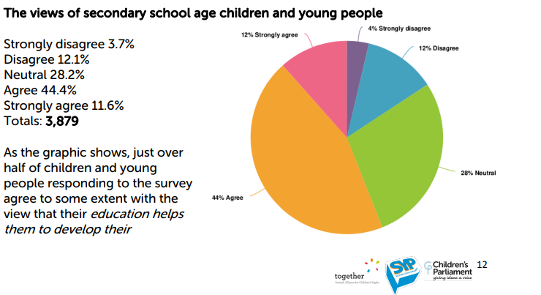
MY EDUCATION HELPS ME TO DEVELOP MY PERSONALITY, TALENTS AND ABILITIES TO THEIR FULLEST POTENTIAL
“In our class, if you want to learn something you go up and ask the teacher. I asked if they wanted to teach about Zodiacs and this will be done next term. We wanted to know what's inside a conker and now we are learning about seeds.”
“It doesn’t help your talent. It only helps with literacy and numeracy.”
Education Reform: Consulting with children and young people (Children’s Parliament, 2022)

Slide 34
What some learners said:
Think about these responses.
Think about all the places you learn, have learned before and will learn in the future.
Think about your personality, talents and abilities.
Think about the future world and prompts from the launch video.

Slide 35
What’s strong?
What’s wrong?
My learning develops my personality, talents, mental and physical abilities
to their fullest potential.
Where are
the challenges?
What’s missing?
Notes:
This grids can be printed off A3 or learners can draw quadrants on a large piece of paper.
Learners are asked to work in teams of about 5:
Think about the statement in the centre in relation to Scottish education in the future.
One idae per post-it note: write down all the things you think are strong / wrong / missing / challenges.
Write straight on to the paper if easier.
Ensure input from everyone in the team.
Identify points of agreement and disagreement to feedback.
Teacher facilitates class discussion coming out of main points. Option to synthesise team sheets into a class response.

Slide 36
Responses
This task will have helped us all think about some of the Discussion questions.
Learners should now either work in groups – or with the facilitator - to complete their group's response
via the following link: https://consult.gov.scot/learning-directorate/national-discussion-feedback
Or, complete their own personal response via the following link:
https://consult.gov.scot/learning-directorate/national-discussion-on-education
If neither of these options fit your group's needs, you can instead choose to email a summary to: nationaldiscussiononeducation@gov.scot, or post on social media #TalkScottishEducation (via Instagram or Twitter). Please remember to include a rough description of who was in your group and how many people took part.
Notes:
From OECD (2020, p54)

Slide 37
Task 4: Open-ended, creative individual or group response
Outline
These slides suggest a range of ways learners could respond in more creative ways.
These could be built into form time, assemblies or lessons over a series of days or weeks, with considerable autonomy given to learners.
Anticipated outputs
This might include creative writing, films, podcasts, blogs, drawings, songs or more.

Slide 38
The National Discussion
Everyone in Scotland is being asked to participate in a National Discussion about education.
The most important group of people are YOU: young people who are learning.
You are being asked to consider the questions on the following two slides and respond in ANY WAY you see fit.
Notes:
From OECD (2020, p54)

Slide 39
Questions for Group Discussion
Key Questions
What kind of education will be needed by children and young people in Scotland in the future and how do we make that a reality?
How do we ensure that children and young people in Scotland feel supported in their learning in the future?
What is one thing that needs to stay and why ?
What are the most important priorities for a future Scottish education system?
How can we make that future vision for education a reality in Scotland?
How can we ensure that everyone involved in education in Scotland has a say in future decisions and actions?

Slide 40
In-depth Questions
Our Future Learning:
How can high quality educational experiences, teaching, and learning be best supported for children and young people in Scotland?
Our Future Equity:
How can every child and young person’s individual needs be supported and addressed in the future?
Our Future Well-Being:
How can children and young people’s mental, emotional, social, and physical wellbeing and safety be cared for and supported in the future?
Our Future Rights:
How can the right of every child and young person to have opportunities to develop their full potential be achieved in future?
Our Future World:
How can children and young people be helped to learn about our changing world, so they feel able to positively contribute?
Opportunity for Additional Comments
Do you have any other comments that you would like to provide about a vision for the future of Scottish Education?

Slide 41
Creative feedback suggestions
To feedback Learners should either work in groups – or with the facilitator - to complete their group's response
via the following link: https://consult.gov.scot/learning-directorate/national-discussion-feedback
Or, complete their own personal response via the following link:
https://consult.gov.scot/learning-directorate/national-discussion-on-education
If neither of these options fit your group's needs, you can instead choose to email a summary to: nationaldiscussiononeducation@gov.scot, or post on social media #TalkScottishEducation (via Instagram or Twitter). Please remember to include a rough description of who was in your group and how many people took part.
If your group wants to spend more time feeding back, they might consider writing a newspaper article, create
a podcast or video, take photographs, write a poem… or something else!
Some ideas are provided on the next few slides to stimulate your thinking…

Slide 42


The Talk Show/Debate
Our future learning
Our future equity
Task: In classes or year groups, create and record a talk show that looks at the future of Scottish Education.
Allocate roles: Talk Show Host; Panel Members (drawn from across the school community - pupils, teachers, parents support staff, janitorial staff, office staff etc) The remainder of participants take on the role of the 'live studio audience'.
Talk Show Host introduces the event and welcomes everyone (including those watching). The Talk Show facilitates the discussion and acts as the link between the panel members and the audience.
Talk Show Host finishes up by thanking the panel and studio audience and the people watching
Our future world
Our future for Scottish education
Our future wellbeing
Our future rights

Slide 43

The School Blog
Our future learning
Our future equity
Task: Either as a whole school or spilt into participatory groups (Year groups, teaching staff, parents etc.), create a school blog on the questions set out in the National Discussion. Each blog is held within the school's website and can be added at intervals during the course of the National Discussion.
Our future world
Our future for Scottish education
Our future wellbeing
Our future rights

Slide 44

Recorded News Report
Our future learning
Our future equity
Task: Researching, preparing and presenting a live/recorded news report on the
National Discussion on Education. Staff and learners research the questions
associated with National Discussion and prepare a news briefing. This can include:
Researching the 5 Ws - Who, What, Why, Where and When - of news galhering
(and also the Howl)
Write out questions that you would want to ask different members of the school community about the Discussion. Some of these questions will need to vary depending on who you are interviewing.
Practice/rehearse asking questions from the national discussion in pairs.
Interviewing and filming members of the school community and asking the questions.
Write out your news story: Remember t.o cover the 5 Ws: What's happening? Who is involved? Where is this happening? When is ii happening? Why 1s it happening? And be: Clear - use simple language. Concise - keep sentences short. Correct - check your facts, grammar and punctuation. When you've done that write a headline - just one short sentence explaining what the story is about. Depending on your school's social media policy and the age of your students, you may ask them to write a tweet or a Facebook post explaining the story.
Edit the material you have into a coherent news bulletin
Our future world
Our future for Scottish education
Our future wellbeing
Our future rights

Slide 45

Podcast
Our future learning
Our future equity
Task: All members of the school community can participate individually or in selected groups in a podcast that focusses on the questions around the National Discussion on Education. The interviews can happen throughout the year and they can be conducted by groups of pupils and staff.
Plan out targeted individuals/groups to interview
Research and plan the questions you wish to ask - use the questions from the National Discussion
Rehearse the questions with a partner(s)
Record the podcast
Publish on school website and/or other media platforms.
Our future world
Our future for Scottish education
Our future wellbeing
Our future rights

Slide 46
What happens next?
Thank you for taking part in the National Discussion.
Education plays a key role in finding solutions to global and local challenges and in making sure children’s rights are respected. That’s why we need to listen carefully to you – whether you are a learner, parent, teacher, practitioner or someone who has an interest in the future of education.
Your response will be independently analysed alongside all other responses to contribute to an inclusive and exciting future vision for Scottish Education.
Follow #TalkScottishEducation on Twitter or Instagram to keep up with the discussion.
The discussion will conclude on 5th Dec 2022. We look forward to reporting back to you in Spring 2023 on the vision you've informed.

Slide 47

© Crown Copyright 2022, Share and Share Alike
This publication is licensed under the terms of the Open Government Licence v3.0 except where otherwise stated. To view this licence, visit nationalarchives.gov.uk/doc/open-government-licence/version/3 or write to the Information Policy Team, The National Archives, Kew, London TW9 4DU, or email: psi@nationalarchives.gsi.gov.uk.
Where we have identified any third party copyright information you will need to obtain permission from the copyright holders concerned.
This publication is available at www.gov.scot
Any enquiries regarding this publication should be sent to us at
The Scottish Government
St Andrew’s House
Edinburgh
EH1 3DG
ISBN: 978-1-XXXXX-XXX-X (web only)
Published by The Scottish Government, September 2022
Produced for The Scottish Government by APS Group Scotland, 21 Tennant Street, Edinburgh EH6 5NA
PPDAS XXXXXXX (09/22)

