Slide 1
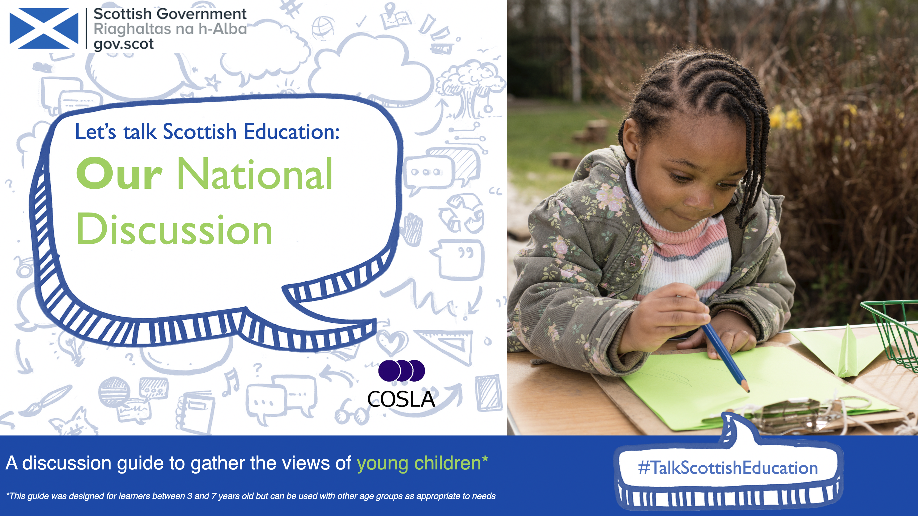

Slide 2

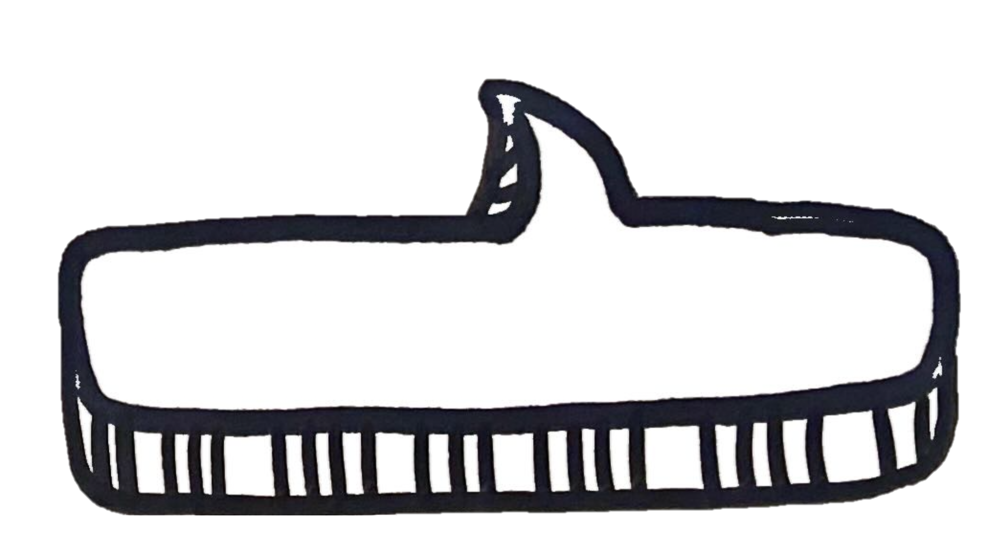
Introduction
This discussion guide has been produced to help gather the views of young children.
This guide has been designed in the form of a picture book to speak directly to young children and explains to them why their views are important and how they can respond.
Please choose between the options within this guide to best suit the needs of your children. You can adapt them as required.
Creative responses are encouraged as we know young children’s voices are expressed through their actions, emotions, and words.
(Realising the Ambition: Being Me, 2020)
This guide has been designed with children between the ages of 3 to 7 in mind but it can also be used with children and young people of all ages who may respond best to this approach.
our future learning
our future learning
our future equity
our future equity
our future world
Our
future for
Scottish education
our future world
our future wellbeing
our future wellbeing
our future rights
our future rights
#TalkScottishEducation

Slide 3
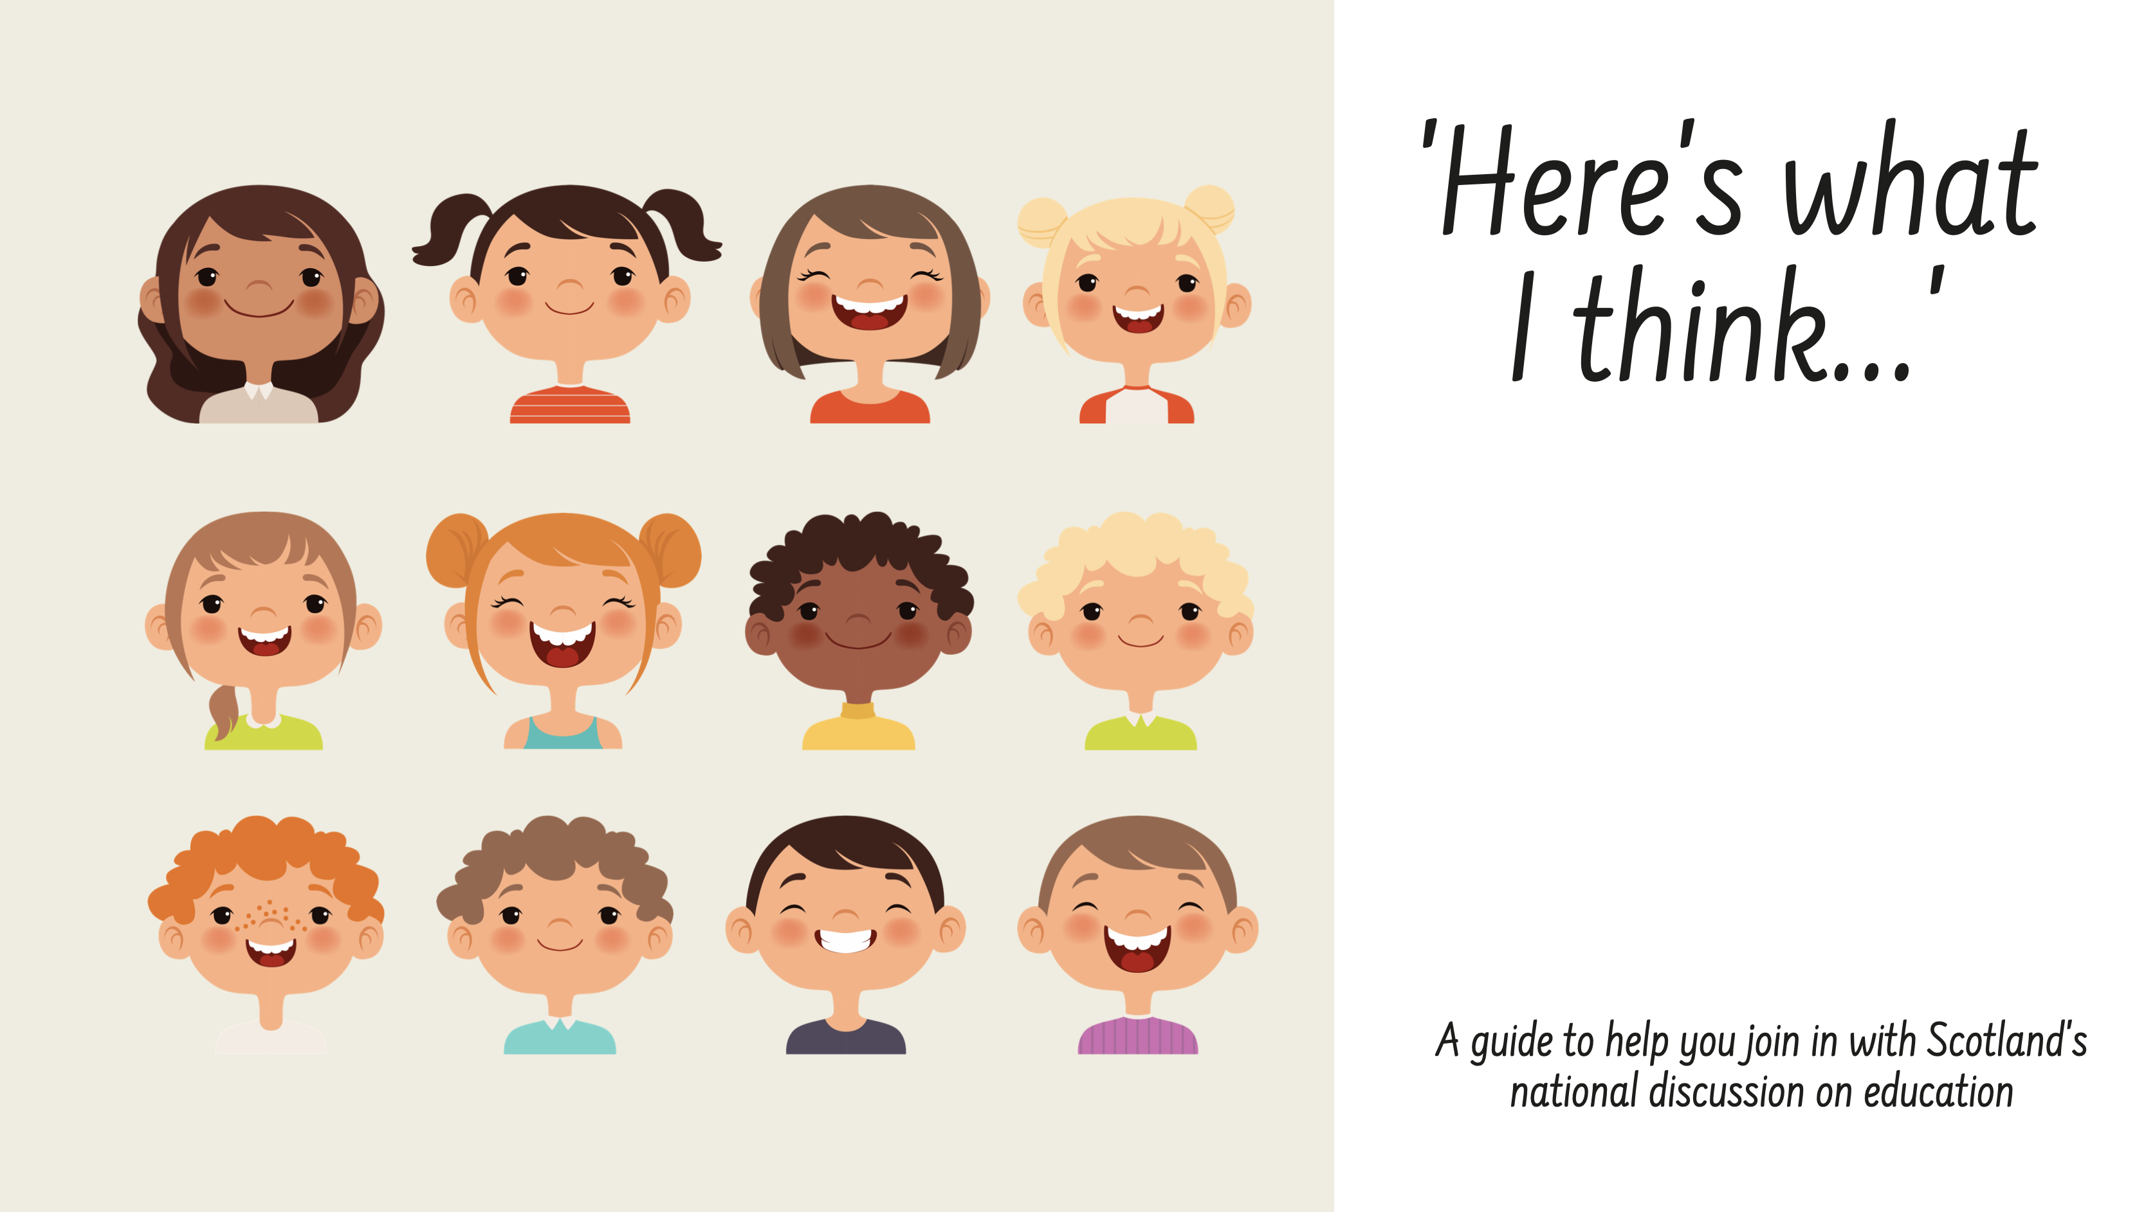

Slide 4
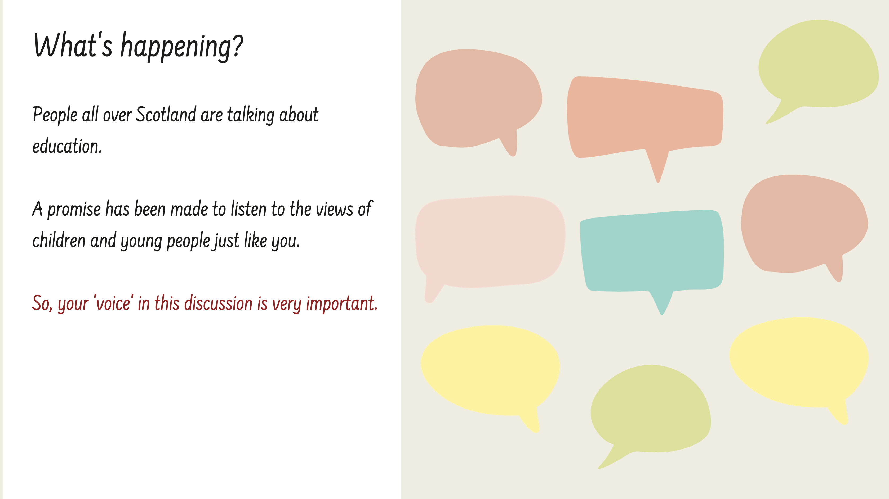

Slide 5
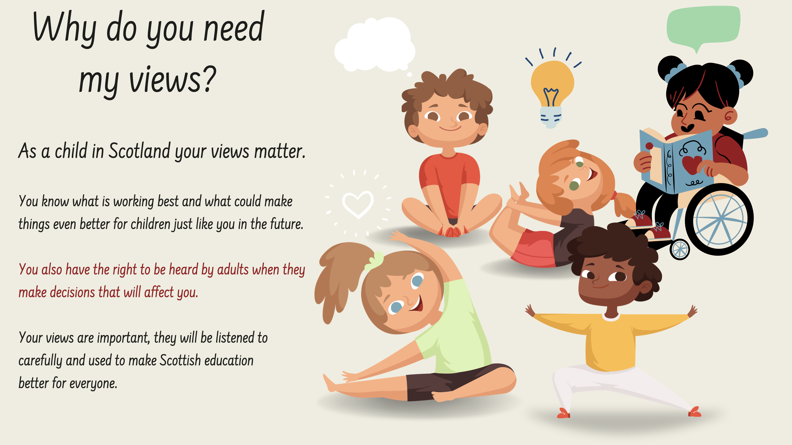

Slide 6
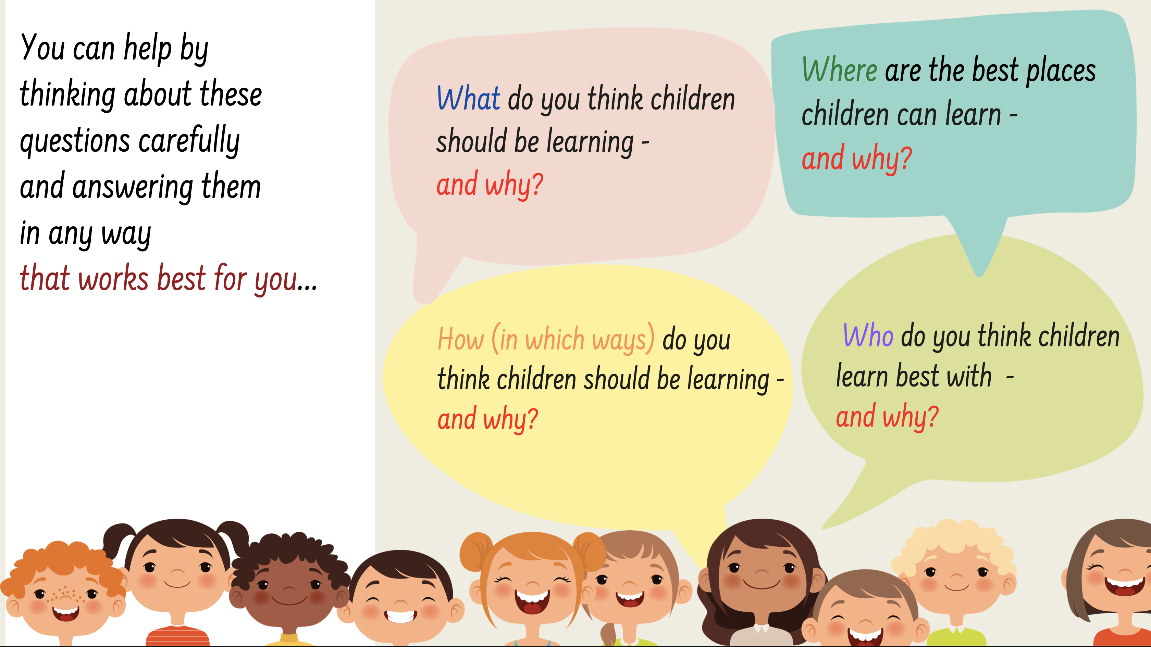

Slide 7
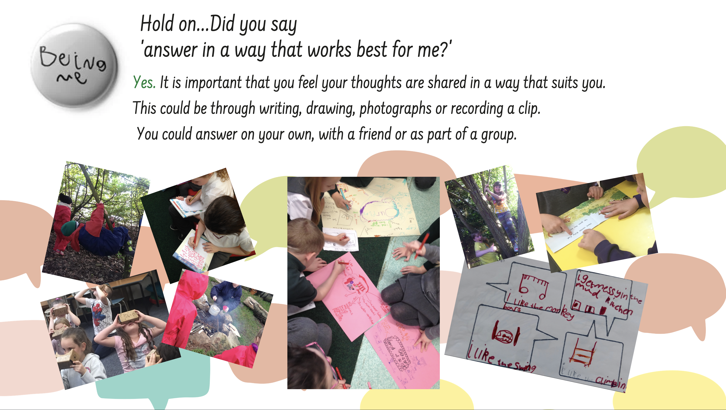

Slide 8
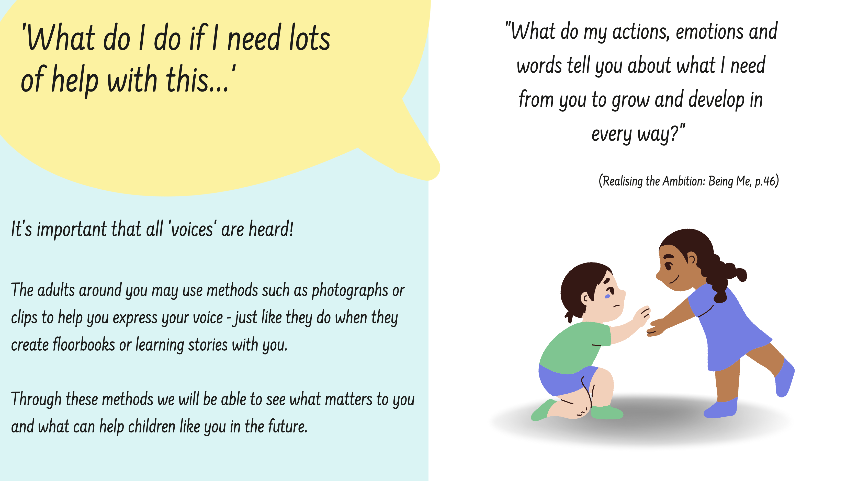

Slide 9
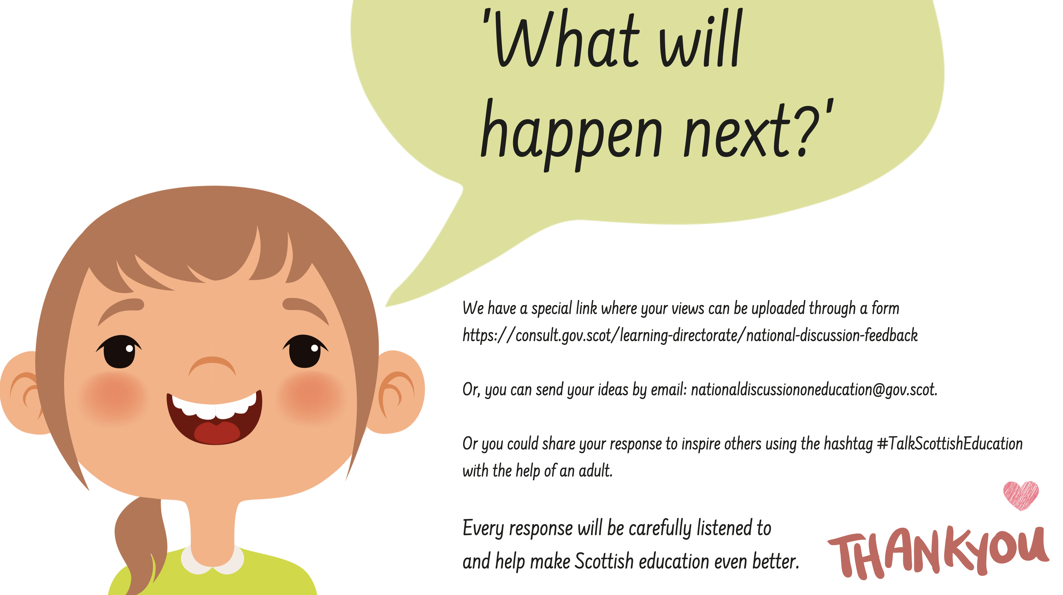
Click here for the form
Click here to email

Slide 10

© Crown Copyright 2022, Share and Share Alike
This publication is licensed under the terms of the Open Government Licence v3.0 except where otherwise stated. To view this licence, visit nationalarchives.gov.uk/doc/open-government-licence/version/3 or write to the Information Policy Team, The National Archives, Kew, London TW9 4DU, or email: psi@nationalarchives.gsi.gov.uk.
Where we have identified any third party copyright information you will need to obtain permission from the copyright holders concerned.
This publication is available at www.gov.scot
Any enquiries regarding this publication should be sent to us at
The Scottish Government
St Andrew’s House
Edinburgh
EH1 3DG
ISBN: 978-1-XXXXX-XXX-X (web only)
Published by The Scottish Government, September 2022
Produced for The Scottish Government by APS Group Scotland, 21 Tennant Street, Edinburgh EH6 5NA
PPDAS XXXXXXX (09/22)

